Slide 1
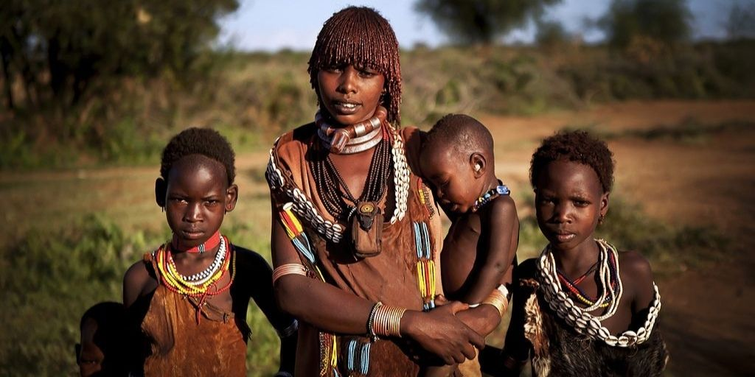
Racial inequalities
Reuben

Slide 2
CON”TENT”
1.What is racial ineuality?
2.Specific Intro

Slide 3
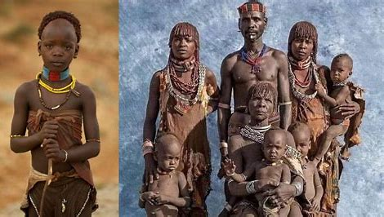
Introduction Racial inequalities around the world What is racial inequaliy?
Over the world,there are three main races: white,yellow,and black people.
The different skin colors made conflicts between two races,and made inequalities.
This is a large problem overworld,and now it is still not solved completely.
Especially for black people,they lived hard and they had been traded as slaves.

Slide 4
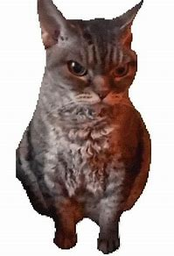
Inequality of blacks
The blacks started to be enslaved by white men can trace back to 16th century.
When the white people found the black people,the free labour that can work for them.Then the blacks are captured to use as a slave,it was free and it had big benefits. The blacks were trade from Africa to Europe and North America using ships with cruel and non-human treatings,they were hard to escape.It was sad and unfair for black people.
In the modern day, there are still about 30 millions of people that are in forced labour

