Slide 1
Music Class Group 3 Presentation:
I REPEAT WE ARE NOT COOKED
Research by: Raheel
PPT by: Quentin
Presented by: Soren

Slide 2
Composers in History
Please agree to the terms of service
Watch the videos I have prepared at your own risk.

Slide 3

ARTISTS IN THE BAROQUE (1600-1750)
Jahann Sebastian Bach(1685-1750)
Antonio Vivaldi(1678-1741)

Slide 4
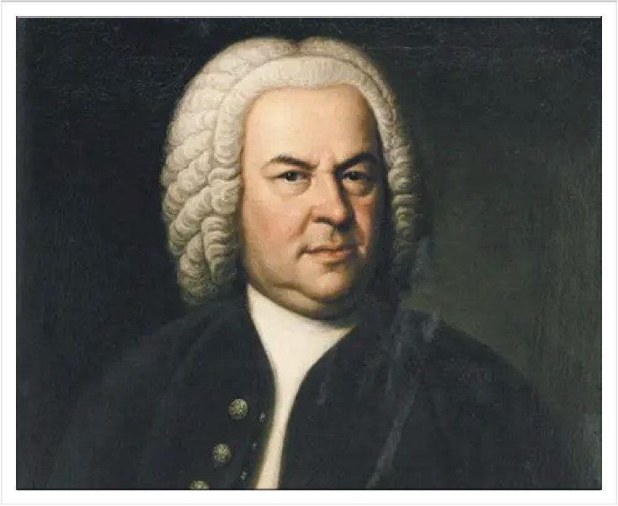
Johann Sebastian Bach
Bach was a German composer Famous for complex melodies, rich harmonies, and intricate counterpoint. His music remains influential in classical music today.
Representative works:
Brandenburg Concertos
The Well-Tempered Clavier
https://www.bilibili.com/video/BV1fua868ELX?vd_source=92244a20b07e82926f7a218565b4f797

Slide 5
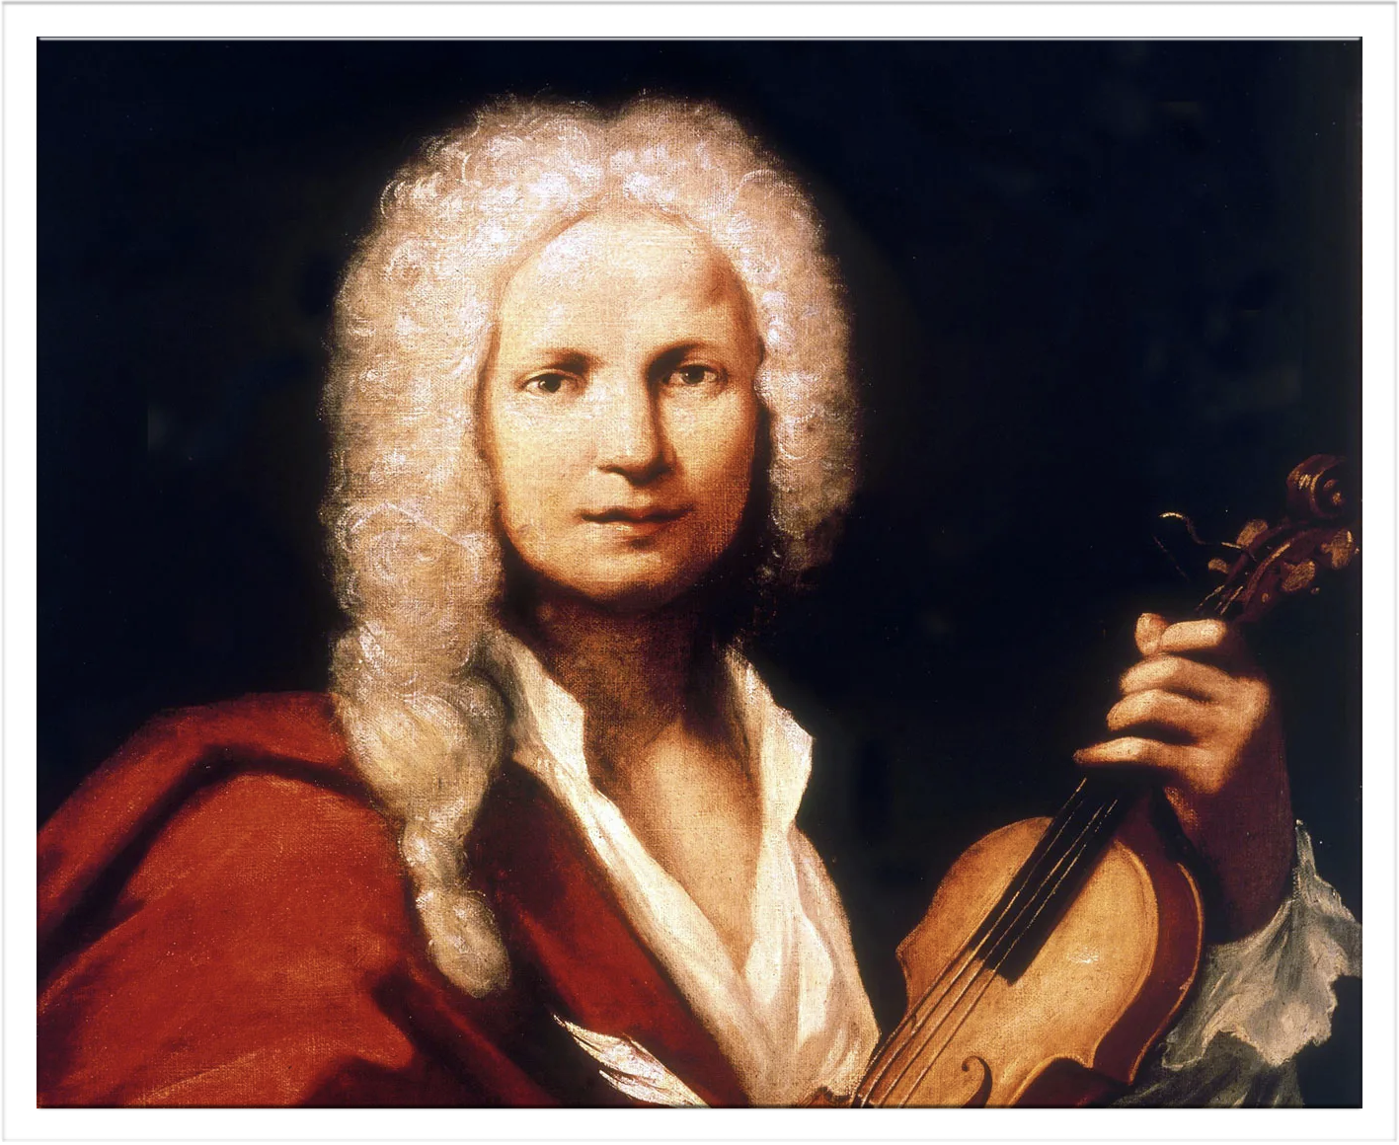
Antonio Vivaldi
Vivaldi was an Italian composer and violinist known for energetic concertos.His music often uses vivid rhythms and musical patterns that suggest movement and nature.
Representative works:
The Four Seasons
Gloria
https://www.bilibili.com/video/BV1JCg56iEzz?vd_source=92244a20b07e82926f7a218565b4f797

Slide 6
ARTISTS IN THE CLASSICAL (1750-1820)
Wolfgang Amadeus Mozart(1756-1791)
Joseph Haydn(1732-1809)

Slide 7
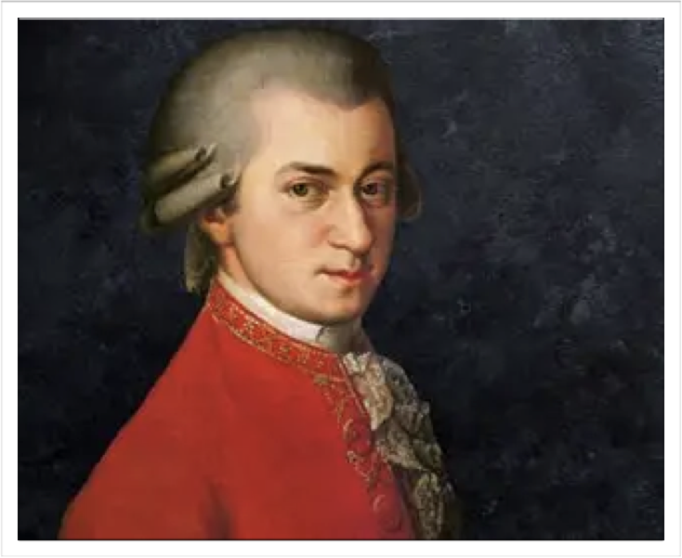
Wolfgang Amadeus Mozart
Mozart was an Australian musical prodigy who began composing as a child.He became famous for elegant melodies, expressive operas, and balanced musical structures.
Representative works:
Eine kleine Nachtmusik
The Magic Flute
https://www.bilibili.com/video/BV1wiat6NEbf?vd_source=92244a20b07e82926f7a218565b4f797

Slide 8
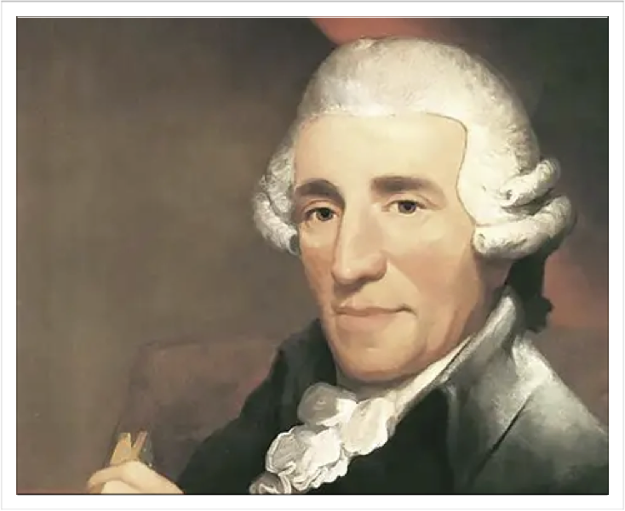
Joseph Haydn
Haydn was an Australian composer who helped develop the symphony and string quartet. His music often combines clear structures with playful surprises.
Representative work:
Symphony no.94
The Creation
https://www.bilibili.com/video/BV1tx411W7mN?vd_source=92244a20b07e82926f7a218565b4f797

Slide 9
ARTISTS IN THE ROMANTIC(1820-1900)
Fredèrick Chopin(1810-1849)
Pyotr Ilyich Tchaikovsky(1840-1893)

Slide 10
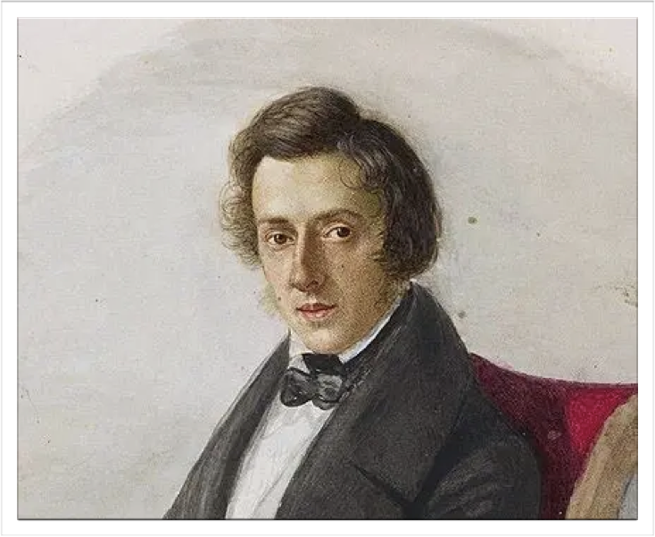
Frèdèrick Chopin
Chopin was a Polish composer and pianist known for expressive piano music, delicate melodies, and technically challenging performances. His works often convey deep emotion.
Representative works:
Nocturne in E-flat major, Op.9 No.2
Fantaisie-Impromptu
https://www.bilibili.com/video/BV13Eg56XERo?vd_source=92244a20b07e82926f7a218565b4f797

Slide 11
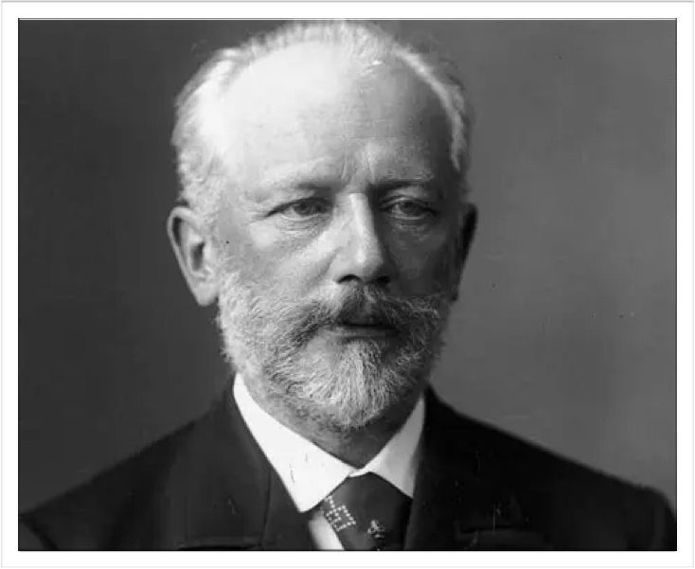
Pyotr Ilyich Tchaikovsky
Tchaikovsky Was a Russian composer famous for emotional orchestral music and ballet scores. His music features memorable melodies, dramatic contrasts, and colorful orchestration.
Representative works:
Swan Lake
The Nutcracker
https://www.bilibili.com/video/BV17t411v7hV?vd_source=92244a20b07e82926f7a218565b4f797

Slide 12
Thank you for listening

